Slide 1
STARTUP ECOSYSTEM
1 Week Faculty Development Programme on
Startup & Innovation
Organized by
Government Engineering College, Patan
June 1, 2020
Dr. Kalpeshkumar L Gupta
Associate Professor of Law, Parul University & Founder of ProBono India, Legal Startups

Slide 2
Agenda
What is Startup Ecosystem?
My experience of startups ecosystem?
Challenges and the Way forward
klgupta.in

Slide 3
Agenda
What is Startup Ecosystem?
My experience of startups ecosystem?
Challenges and the Way forward
klgupta.in

Slide 4
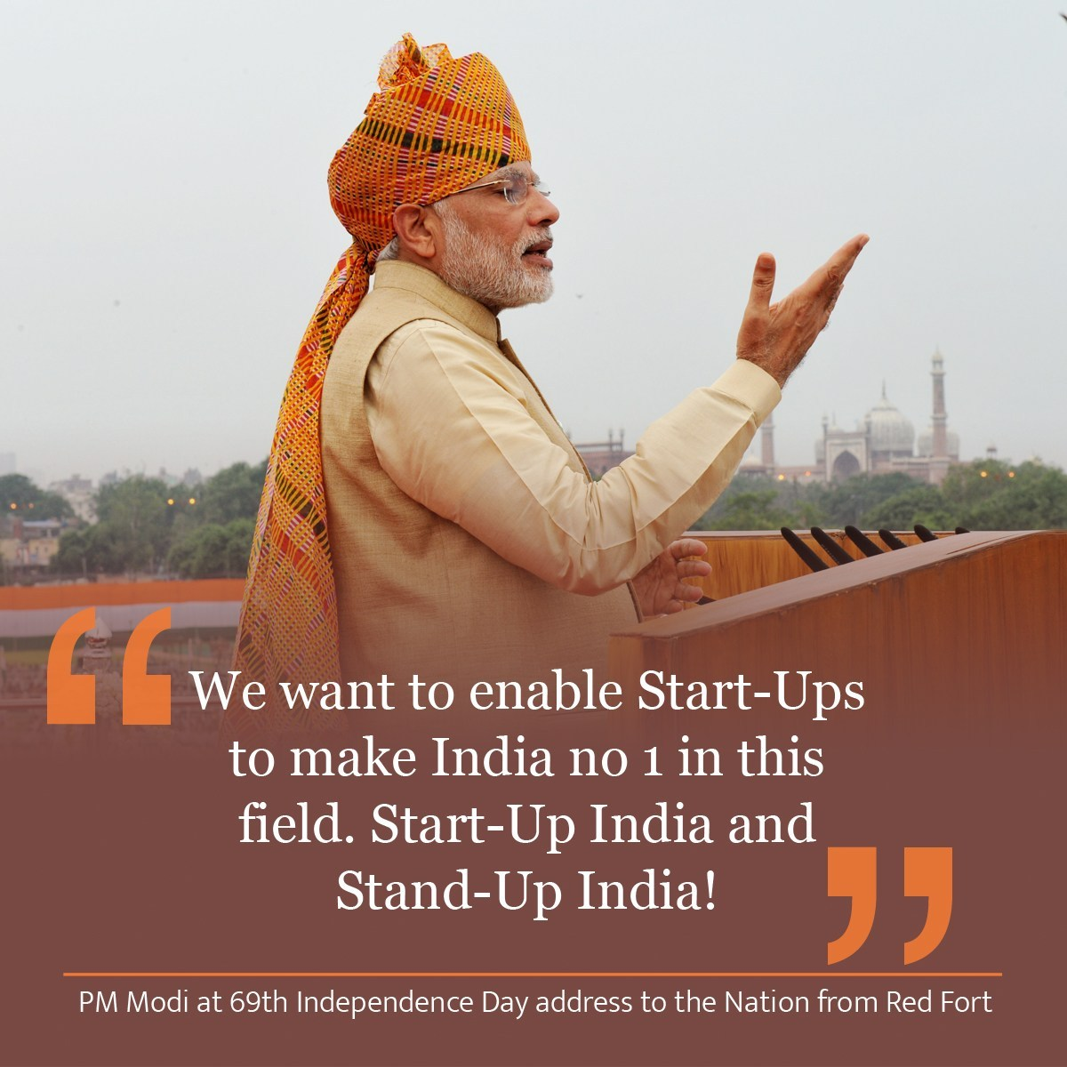
The campaign was first announced by Indian Prime Minister, Narendra Modi during his 15 August 2015 address from the Red Fort, in New Delhi.
The action plan of this initiative, is based on the following three pillars:
1. Simplification and Handholding.
2. Funding Support and Incentives.
3. Industry-Academia Partnership and Incubation.
Cont…
klgupta.in

Slide 5
Gujarat best state in providing strong ecosystem for startups: Dept of Industrial Policy & Promotion ranking
2018 Startup State Ranking are as follows:
Best performer: Gujarat
Top performers: Karnataka, Kerala, Odisha, and Rajasthan
Leader: Andhra Pradesh, Bihar, Chhattisgarh, Madhya Pradesh, and Telangana
Aspiring leaders: Haryana, Himachal Pradesh, Jharkhand, Uttar Pradesh, and West Bengal
Emerging states: Assam, Delhi, Goa, Jammu & Kashmir, Maharashtra, Punjab, Tamil Nadu, and Uttarakhand
Beginners: Chandigarh, Manipur, Mizoram, Nagaland, Puducherry, Sikkim, and Tripura
https://economictimes.indiatimes.com/small-biz/startups/newsbuzz/gujarat-best-state-in-providing-strong-ecosystem-for-startups-dipp-ranking/articleshow/67176184.cms
klgupta.in

Slide 6
MINISTRY OF COMMERCE AND INDUSTRY (Department of Industrial Policy and Promotion) NOTIFICATION New Delhi, the 11th April, 2018
An entity shall be considered as a Startup:
i. Upto a period of 7 years from the date of incorporation/registration,
if it is incorporated as a private limited company (as defined in the Companies Act, 2013) or registered as a partnership firm (registered under section 59 of the Partnership Act, 1932) or a limited liability partnership (under the Limited Liability Partnership Act, 2008) in India.
In the case of Startups in the biotechnology sector, the period shall be upto 10 years from the date of its incorporation/ registration.
ii. Turnover of the entity for any of the financial years since incorporation/ registration has not exceeded Rs. 25 crore
iii. Entity is working towards innovation, development or improvement of products or processes or services, or if it is a scalable business model with a high potential of employment generation or wealth creation.
Cont…
https://dipp.gov.in/sites/default/files/Startup_Notification11April2018_0.pdf
klgupta.in

Slide 7
Cont…
MINISTRY OF COMMERCE AND INDUSTRY (Department of Industrial Policy and Promotion) NOTIFICATION New Delhi, the 11th April, 2018
Provided that an entity formed by splitting up or reconstruction of an existing business shall not be considered a ‘Startup’.
Explanation
An entity shall cease to be a Startup on completion of 7 years from the date of its incorporation/ registration or if its turnover for any previous year exceeds Rupees 25 crore.
In respect of Startups in the biotechnology sector, an entity shall cease to be a Startup on completion of 10 years from the date of its incorporation/ registration or if its turnover for any previous year exceeds Rs. 25 crore.
https://dipp.gov.in/sites/default/files/Startup_Notification11April2018_0.pdf
klgupta.in

Slide 8
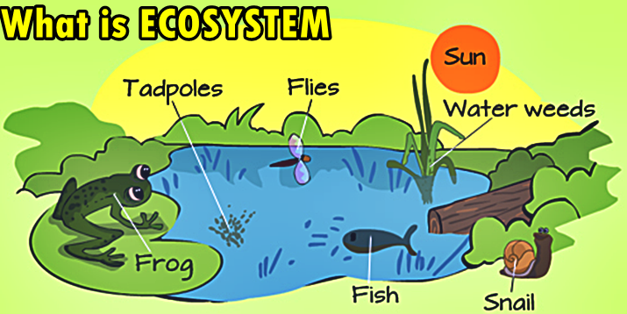
What is Ecosystem ?.....scientific term
An ecosystem is a community of living organisms in conjunction with the nonliving components of their environment, interacting as a system.
klgupta.in

Slide 9
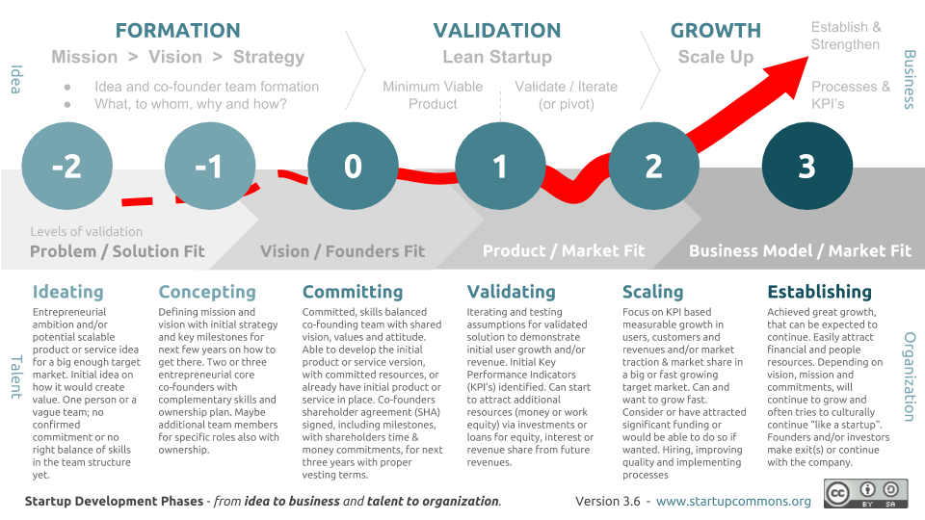
Stages of Startup & Startup Ecosystem
Start Ecosystem means all support system required during the period of Startup Journey.
klgupta.in

Slide 10
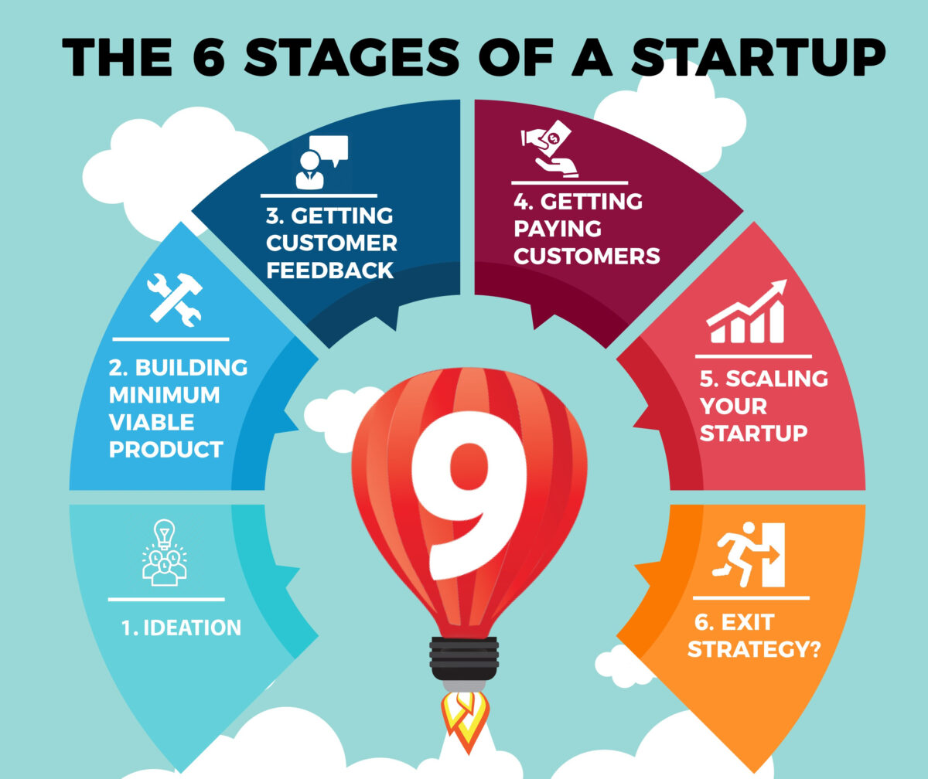
Stages of Startup & Startup Ecosystem
https://www.thecontentstartup.com/what-are-the-phases-of-a-startup/
klgupta.in

Slide 11
What is Startup Ecosystem?
A startup ecosystem is formed by people, startups in their various stages and various types of organizations in a location (physical and/or virtual), interacting as a system to create new startup companies.
These organizations can be further divided into categories: universities, funding organizations, support organizations (like incubators, accelerators, co-working spaces etc.), research organizations, service provider organizations (like legal, financial services etc.) and large corporations. Different organizations typically focus on specific parts of the ecosystem function and/or startups at their specific development stage(s).
https://www.startupcommons.org/what-is-startup-ecosystem.html
klgupta.in

Slide 12
What is Startup Ecosystem?
https://www.startupcommons.org/what-is-startup-ecosystem.html
klgupta.in

Slide 13
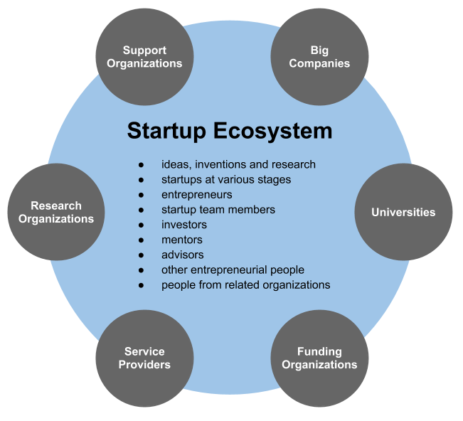
Startup Ecosystem
https://www.startupcommons.org/what-is-startup-ecosystem.html
klgupta.in

Slide 14
Startup Ecosystem
Startup Ecosystem
Institutions/Univ.
Govt.
Budding Entrepreneur
Pvt. Players
klgupta.in

Slide 15
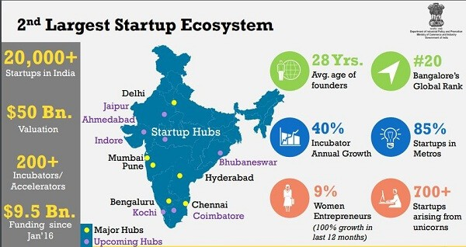
Startup Ecosystem
The Indian Startup Ecosystem in 2020*
*https://www.linkedin.com/pulse/indian-startup-ecosystem-2020-anil-gupta-er-anil-guru-/
klgupta.in

Slide 16
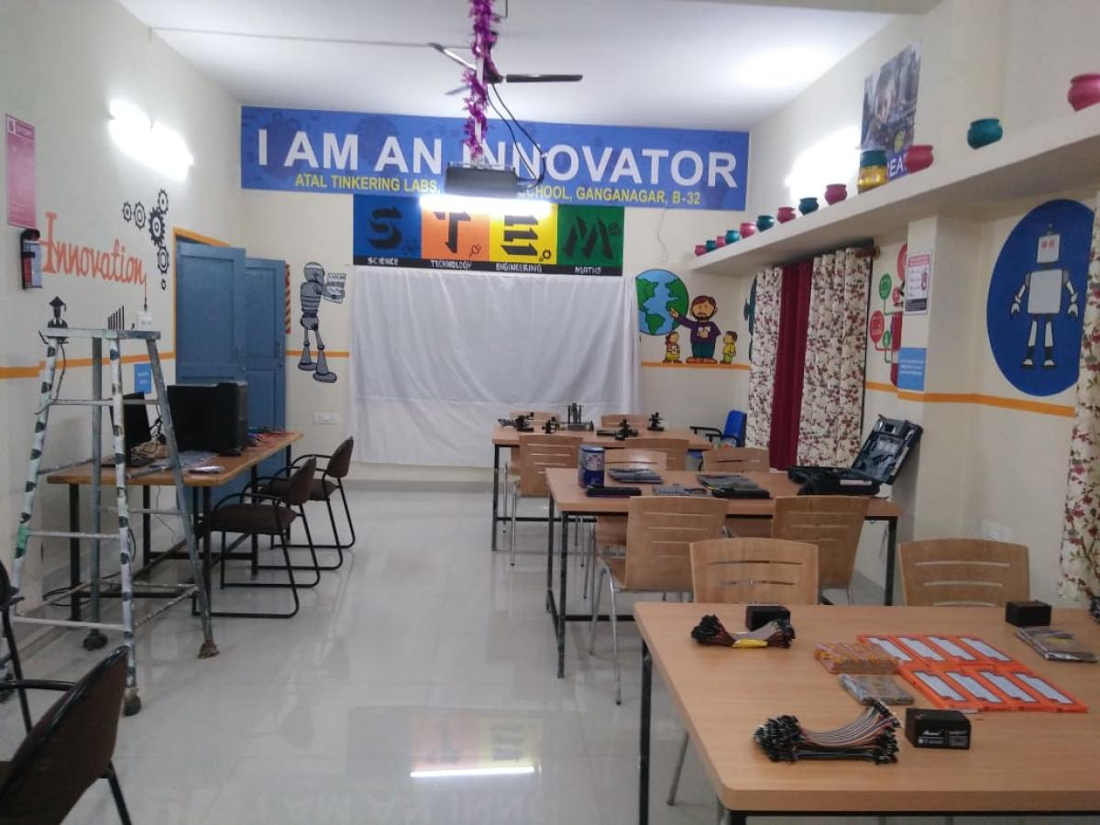
Example :- Tinkering Labs under Atal Innovation Mission
klgupta.in

Slide 17
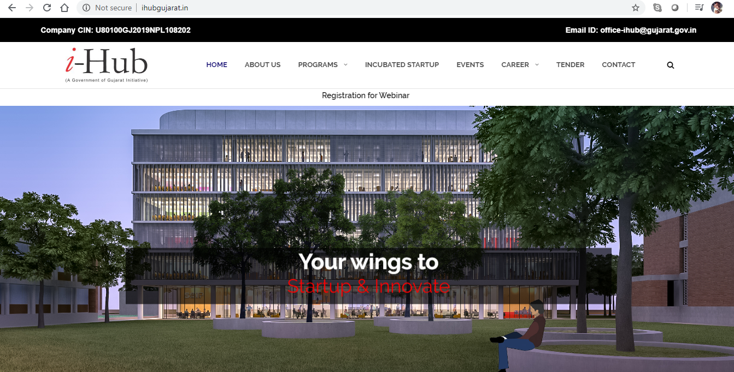
Example :- i-Hub set up by Govt. of Gujarat
Gujarat Student Startup and Innovation Hub, registered under Section 8 of the companies Act 2013, is envisioned to be a nexus for all Startup stakeholders to develop an end-to-end innovation and entrepreneurial ecosystem in the State of Gujarat by creating pathways from “Mind-to-Market”. i-hub is a vibrant incubation setup established under SSIP by the Education Department, Government of Gujarat.
klgupta.in

Slide 18
Section 8 Company
A Section 8 Company is registered as a limited company under section 8 of Companies Act, 2013 and holds the licence from Central Government, having the following features:
a. has in its objects the promotion of commerce, art, science, sports, education, research, social welfare, religion, charity, protection of environment or any such other object;
b. intends to apply its profits, if any, or other income in promoting its objects; and
c. intends to prohibit the payment of any dividend to its members,
Central government, if it deems fit, may issue license to the applicant company to be registered as a limited company under Section 8 of Companies Act, 2013. However, the company is not allowed to use the words “Limited” / “Private Limited” in his name.
klgupta.in

Slide 19
90% Of Indian Startups Will Fail Because Of Lack Of Innovation, Study Says
Of late, India might have become the third-largest startup ecosystem, but it lacks successful innovation.
Notwithstanding the fact that market valuation of Indian startups has grown significantly over the past four years, a recent study, “Entrepreneurial India,” by the IBM Institute for Business Value and Oxford Economics found that 90% of Indian startups fail within the first five years. And the most common reason for failure is lack of innovation.
77% of venture capitalists surveyed believe that Indian startups lack new technologies or unique business models
https://www.forbes.com/sites/suparnadutt/2017/05/18/startups-in-india-fail-due-lack-of-innovation-according-to-a-new-ibm-study/#201e3c89657b
klgupta.in

Slide 20
90% Of Indian Startups Will Fail Because Of Lack Of Innovation, Study Says
It's well known that most Indian startups are prone to emulate successful global ideas, by and large fine-tuning an existing model to serve local needs.
https://www.forbes.com/sites/suparnadutt/2017/05/18/startups-in-india-fail-due-lack-of-innovation-according-to-a-new-ibm-study/#201e3c89657b
klgupta.in

Slide 21
Agenda
What is Startup Ecosystem?
My experience with startups ecosystem?
Challenges and the Way forward
klgupta.in

Slide 22
GNLU Legal Incubation Council (Sec. 8 Company)
IncMent
E-Cell
Research
IncMent - Incubation & Mentorship, it will incubate and mentor the startups.
E-Cell - Inculcate and promote culture of entrepreneurship by way of forming Entrepreneurship Cell, consisting of law and management students of the university.
Research - On entrepreneurship and allied aspects
klgupta.in

Slide 23
Funds with GNLU Legal Incubation Council
University’s Fund
Fund received from Industries Commissionerate, Govt. of Gujarat mainly for setting up of system in 2017
Fund received from Education Department, Govt. of Gujarat under Student Startup & Innovation Policy (SSIP) in 2017
klgupta.in

Slide 24
http://legalstartups.info/
Founder :- Dr. Kalpeshkumar L Gupta
Founded in :- 2018
klgupta.in

Slide 25
My Story
2016
2017
klgupta.in
probono-india.in
2018
2019
legalstartups.info
courtmanagement.in
klgupta.in

Slide 26
Agenda
What is Startup Ecosystem?
My experience of startups ecosystem?
Challenges and the Way forward
klgupta.in

Slide 27
Challenges
Faculty handling startups activities
Convincing students for startup related activities
Non inclusion of Startup, Entrepreneurship related topics in curriculum
Management Support
Govt. Support
Collaboration between institutions
Cumbersome process for providing support to startup
klgupta.in

Slide 28
The Way Forward
Faculty interested in startup related activities should be appointed
Building of students team by creating E-Cell
Inclusion of Startup, Entrepreneurship subjects, topics in curriculum and provide incentives
Convince management with proper proposal for building ecosystem
Collaborate with other institutions and build synergy
Sound Startup policy by Govt., Institutions
klgupta.in

Slide 29
Any questions?
klgupta.in

Slide 30
Dr. Kalpeshkumar L Gupta
www.klgupta.in

